Slide 1
USED CAR PRICE PREDICTION Project Presentation
Submitted By | Ankit Dadarwala | Data Science Intern at Flip Robo Technologies

Slide 2

Introduction
Problem Statement:
With the covid 19 impact in the market, we have seen lot of changes in the car market. Now some cars are in demand hence making them costly and some are not in demand hence cheaper. One of our clients works with small traders, who sell used cars. With the change in market due to covid 19 impact, our client is facing problems with their previous car price valuation machine learning models. So, they are looking for new machine learning models from new data. We have to make car price valuation model.

Slide 3
Introduction
The digital revolution is disrupting used-car retailing—for the better. This new wave of digital retailing represents more than technology alone because it focuses a spotlight on the importance of the customer experience in the used-car-buying process. As revealed by our proprietary customer research, online providers are beginning to dilute traditional used-car dealers’ positions and drive growth by empowering digitally savvy customers via three major capabilities:
Complete end-to-end purchasing capabilities
Extensive vehicle data and photos, along with effective search tools
Unique delivery options
With the rise of digital players and potential incumbent-dealer consolidation on the horizon, the evolving market will feature new threats and opportunities for players trying to capture value in an already competitive environment. Furthermore, while the ways customers purchase vehicles are changing, it’s also true that the needs of used-car buyers differ far more than those of new-vehicle purchasers. As a result, to generate a uniformly distinctive and differentiating customer experience, all used-car retailers must identify their target customer segments and rapidly develop the best approaches among a growing array of available options.

Slide 4

Exercise
Build a model which can be used to predict in terms of a probability for each car price transaction,.
In this case, target column has continues values so we used regression based models.

Slide 5
Points to remember
There are no duplicates values in the dataset.
There are 88 null values in transmission column.
Data take by selenium web scraping tool
Size of the dataset is 4041 rows and 10 columns with target
We have scrap car data like brands, model, fuel type, transmission type, manufacturing years, location, owners, driven km, price
include all types of cars in your data for example- SUV, Sedans, Coupe, minivan, Hatchback.

Slide 6
Project Goals
Analytical Problem Framing
Exploratory Data Analysis (EDA)
Visualizations
Data Pre-Processing on train and test datasets
Model/s Development and Evaluation
Performing hyper parameter tuning, saving the best model and predicting the target
Conclusion and future work discussion

Slide 7
column Description
Transmission:→ categorical feature with Automatic and Manual type values
Variant:→ categorical feature with different type of engine type values Like (LXI,VXI,VDI,ZDI,1.5L,2.0L etc.)
Km driven:→ int base column in that cars driven km show
Owner:→ categorical feature with value of 1st,2nd, etc..
Fuel type:→ In this category of fuel type like petrol, diesel..
Price:→ Target column INT base
City:→ list of different cities of India
Mfg. year:→ manufacturing year of cars
Company name:→ List of the cars brand name
Model name:→ list of different car models of the different company

Slide 8
Exploratory Data Analysis
First scrap data from the cars24.com and make data frame than save as csv format file.
I have imported the necessary libraries and loaded the entire dataset in our Jupyter Notebook and renamed the project file from untitled.
Then I checked the shape of our dataset and found that we have a total of 4041 rows and 10 different columns.
We have 88 null values or missing values present in our dataset.
By checking the data types I came to know that our data set consists of columns have float, integer and object data type values.
Shape : 4041 rows and 10 columns
88 null values present
No Duplicate record found
Datatypes of float, integer and object are in dataset

Slide 9
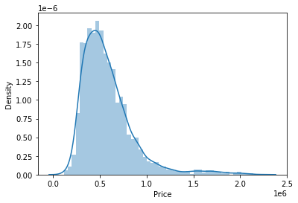
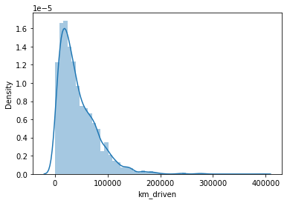
Describe
Here we see a statistical representation of the all the numeric data columns.
In that have skewness so treat them with different methods

Slide 10
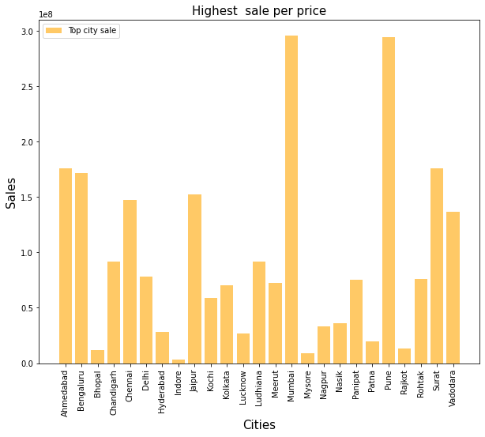
Bivariate Analysis
SELLING CARS IN DIFFERENT CITITES
With the help of Bar Plot we are able to see the success and failure label data for the columns basically the feature data.

Slide 11
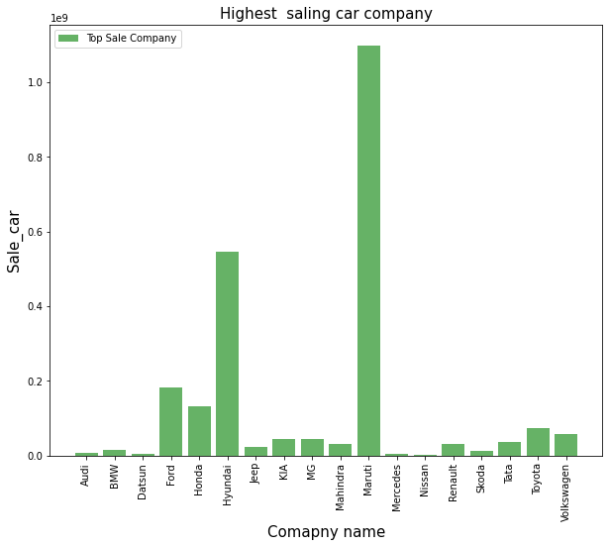
SELLING OF DIFFERENT CAR BRANDS

Slide 12
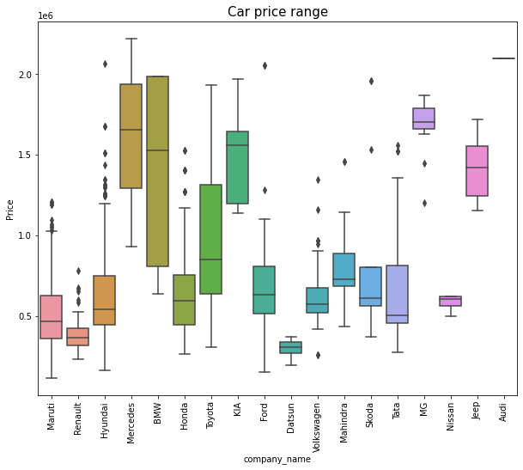
PRICE RANGE OF DIFFERENT CAR BRANDS

Slide 13
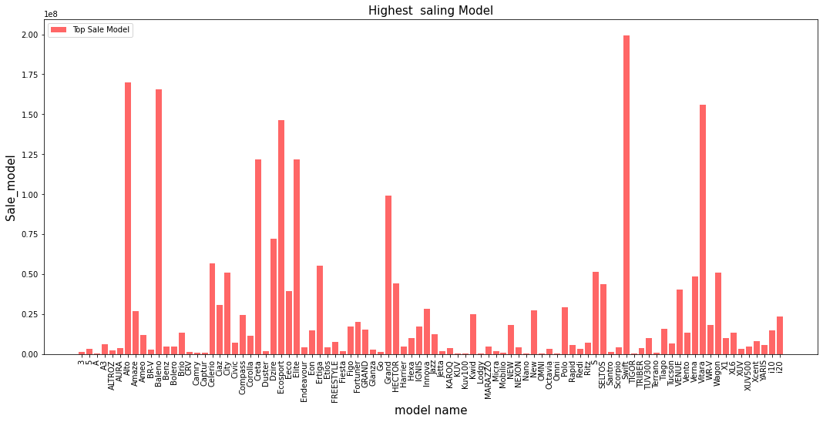
SELLING OF DIFFERENT CAR BRAND MODELS

Slide 14
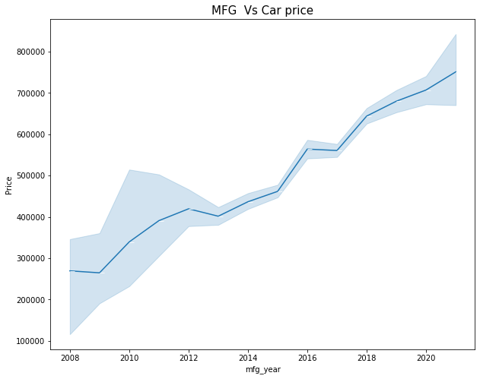
SENARIO OF CAR PRICE WITH RESPECT TO MFG. YEARS

Slide 15
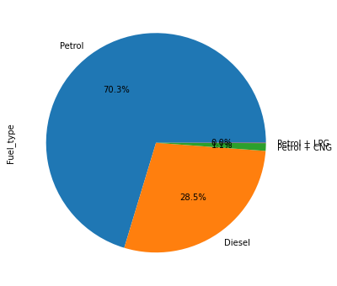
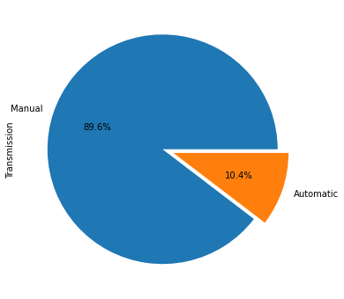
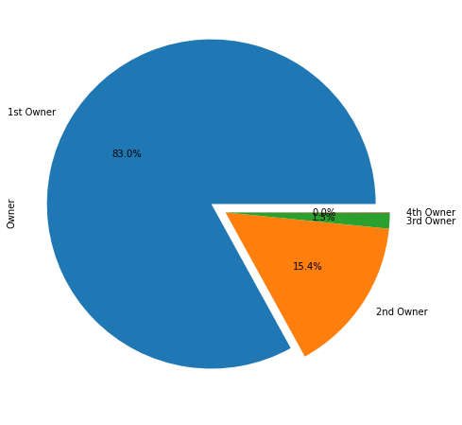
DIFFERENT CAR PROPERITIES AND THEIR PREFERANCES

Slide 16
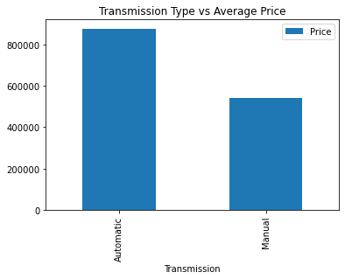
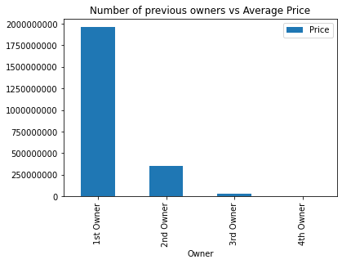
PRICE ACCORDING TO FEATURES

Slide 17
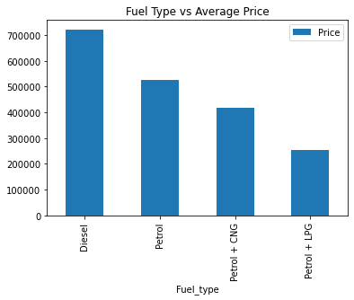
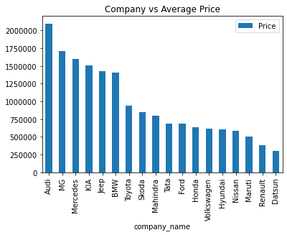
PRICE ACCORDING TO FEATURES

Slide 18
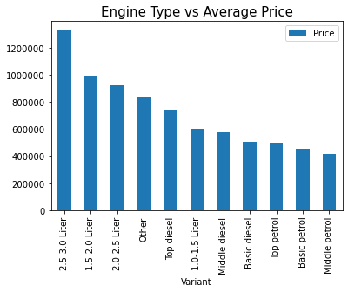
PRICE ACCORDING TO FEATURES

Slide 19
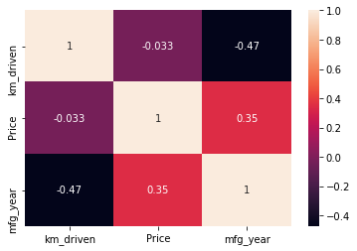
CORRELATION HEAT MAP GRAPH
CORRELATION HEAT MAP
manufacturing years are positively co-related with price which indicate manufacturing the car how old it’s.
km driven of cars are negatively co-related with price that means how car used in past.

Slide 20
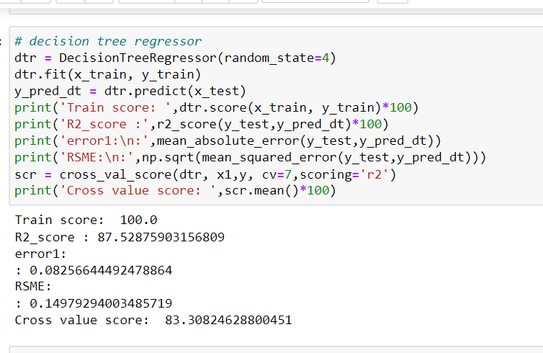
Run and evaluate select models
1). Decision Tree Regressor
I created this REGRESSION function to obtain the various input model details along with metric information on R2 SCORE, cross validation, the AME and RSME the difference between accuracy and cross validation using 7 folds to avoid overfitting and underfitting concerns.

Slide 21
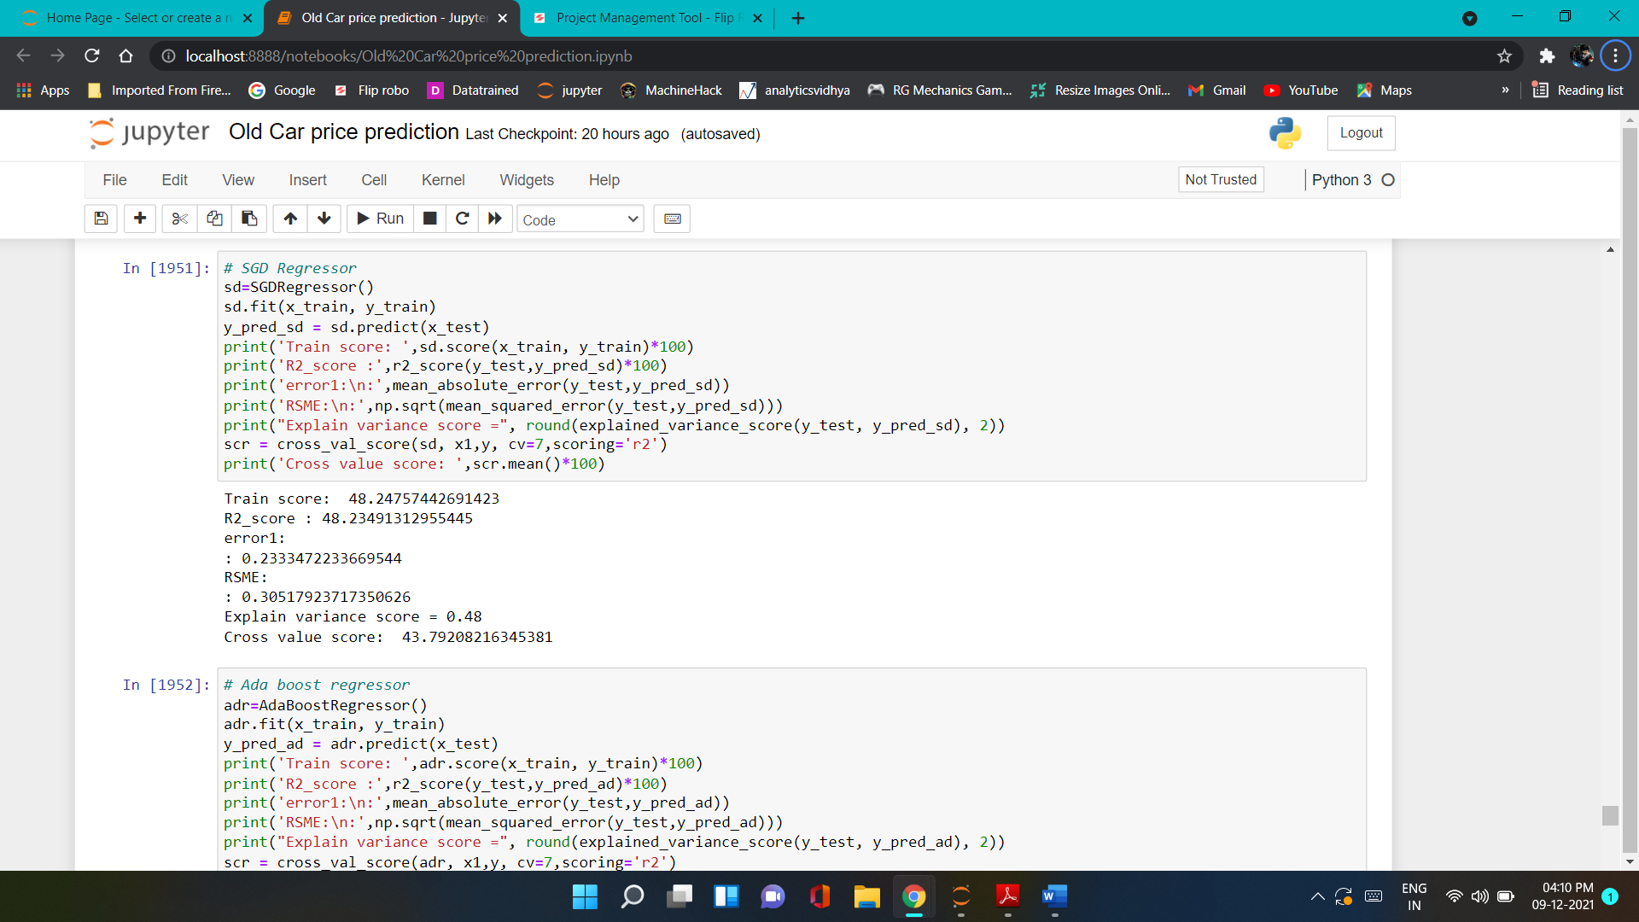
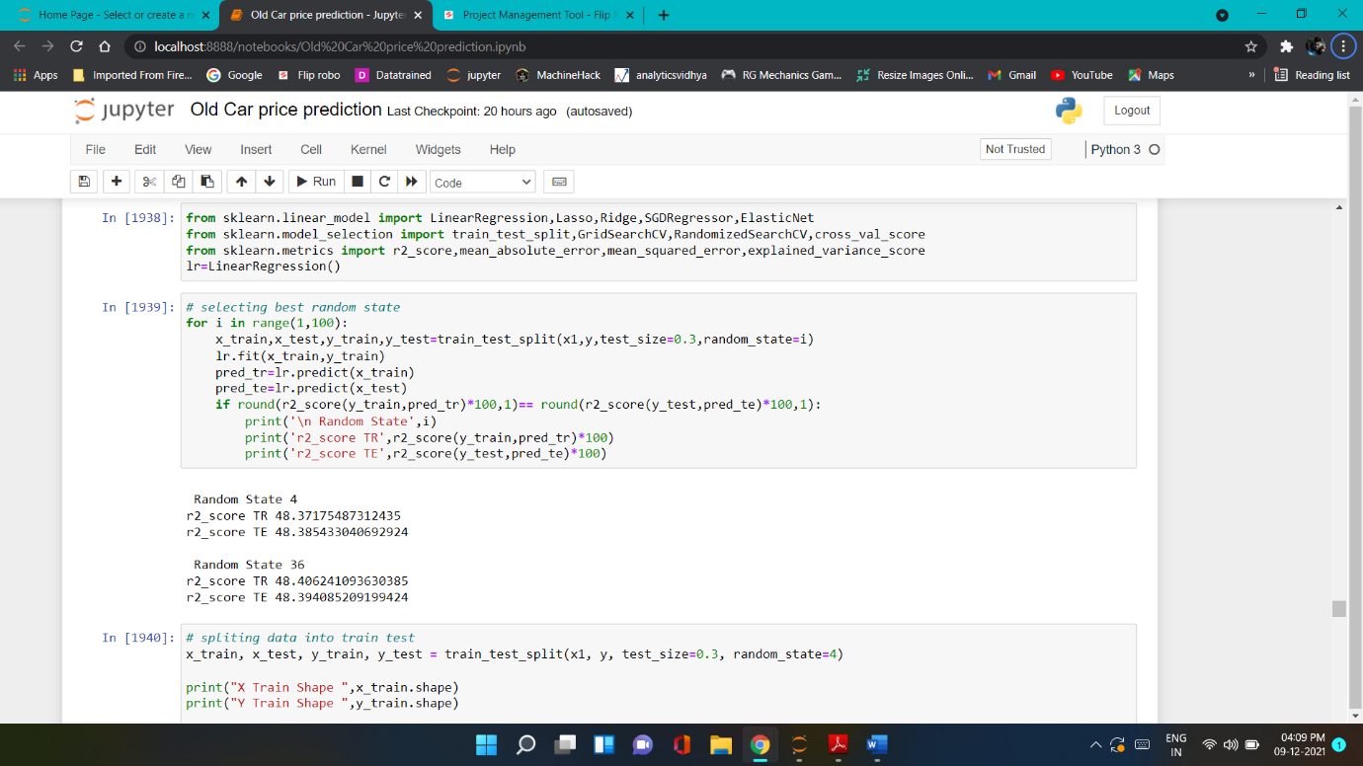
Run and evaluate select models
2).SGD Regressor
3).Linear Regressor

Slide 22
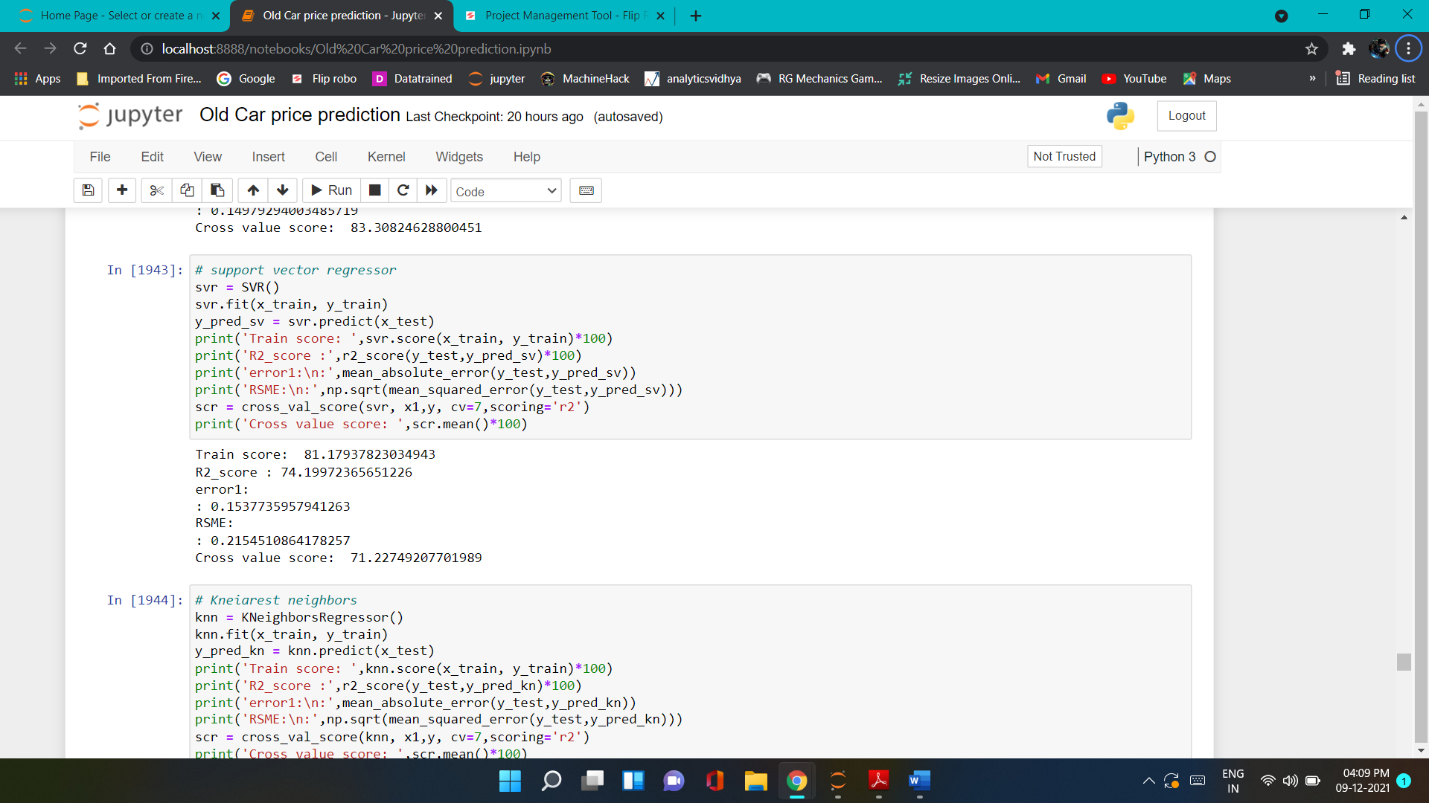
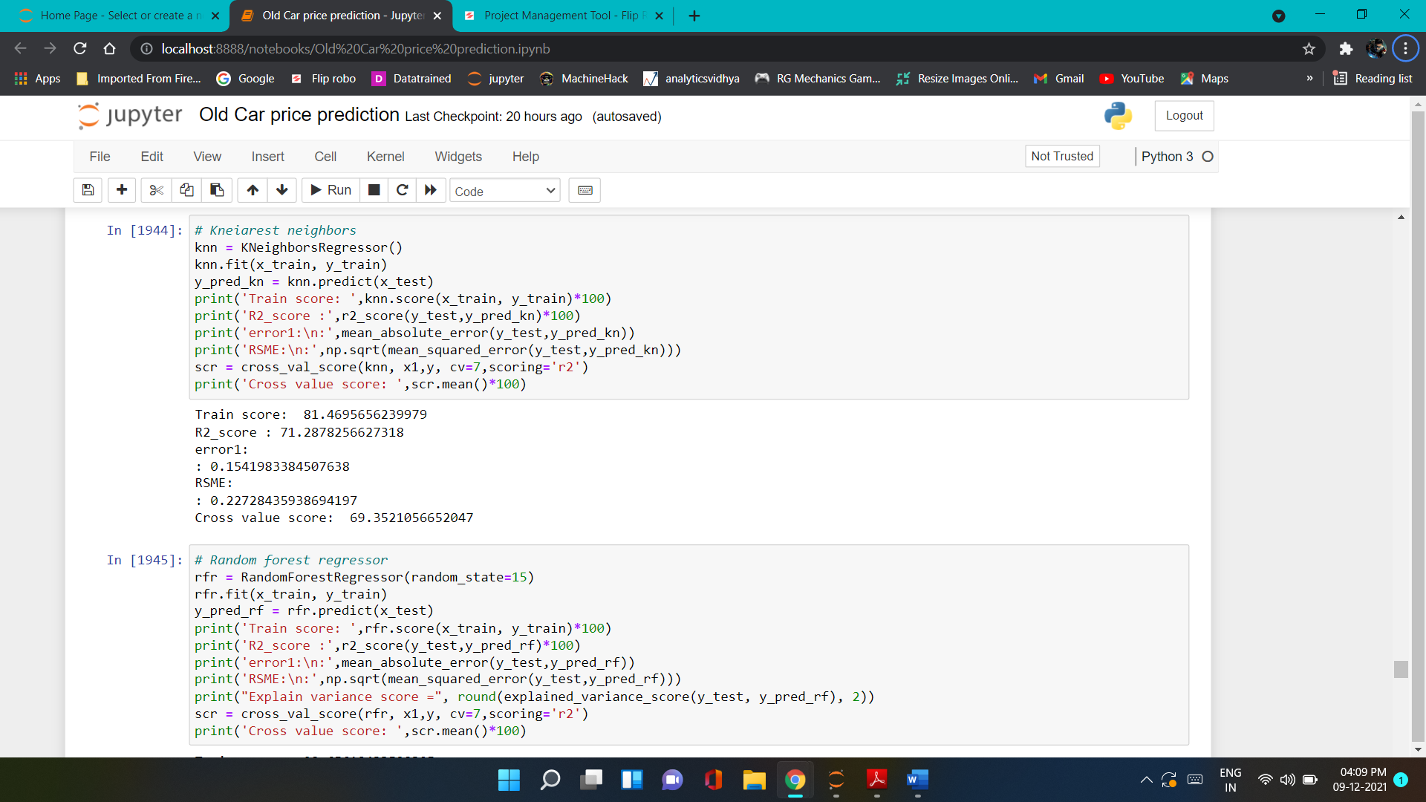
Run and evaluate select models
4).SVM Regressor
5).KNeighbors Regressor

Slide 23
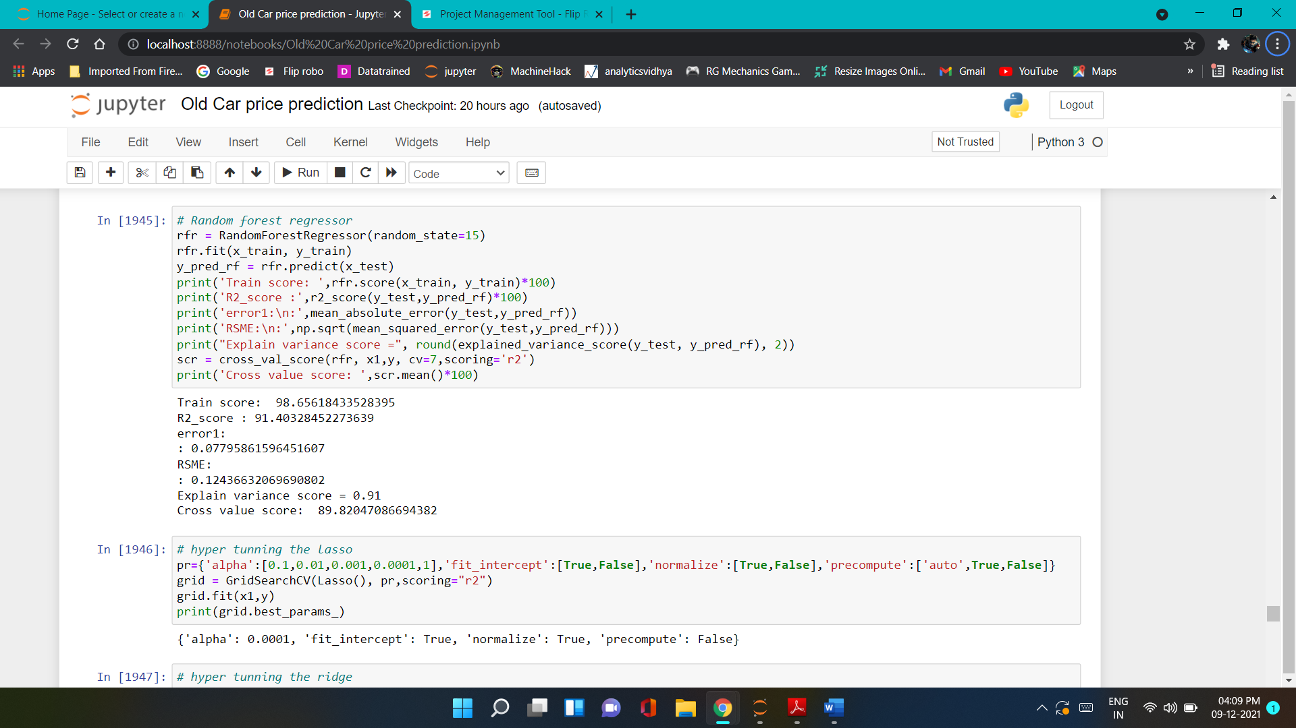
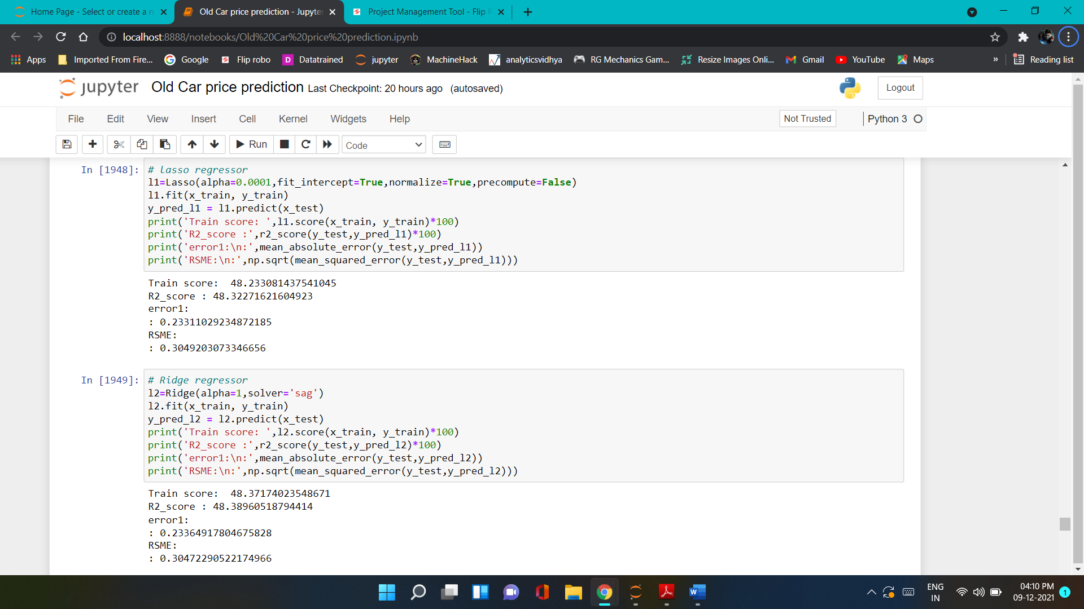
Run and evaluate select models
6).Random forest Regressor
7).Lasso & Ridge Regressor

Slide 24
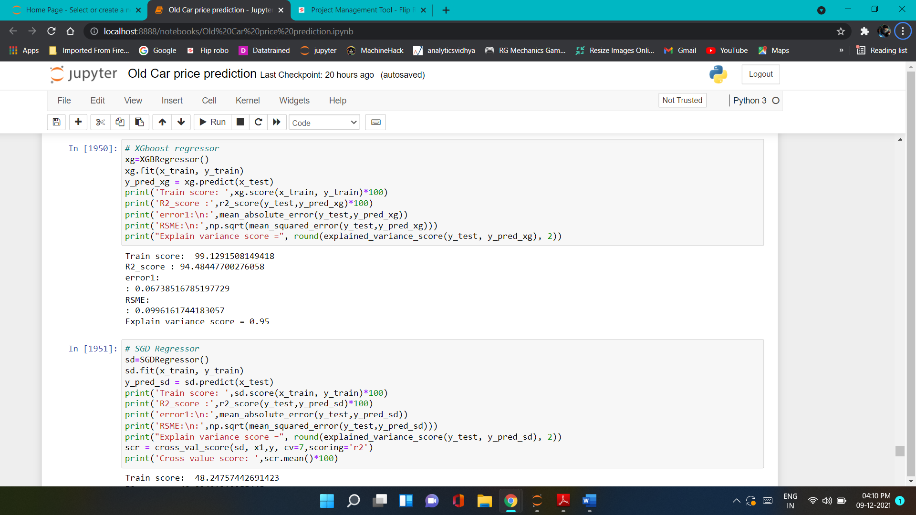
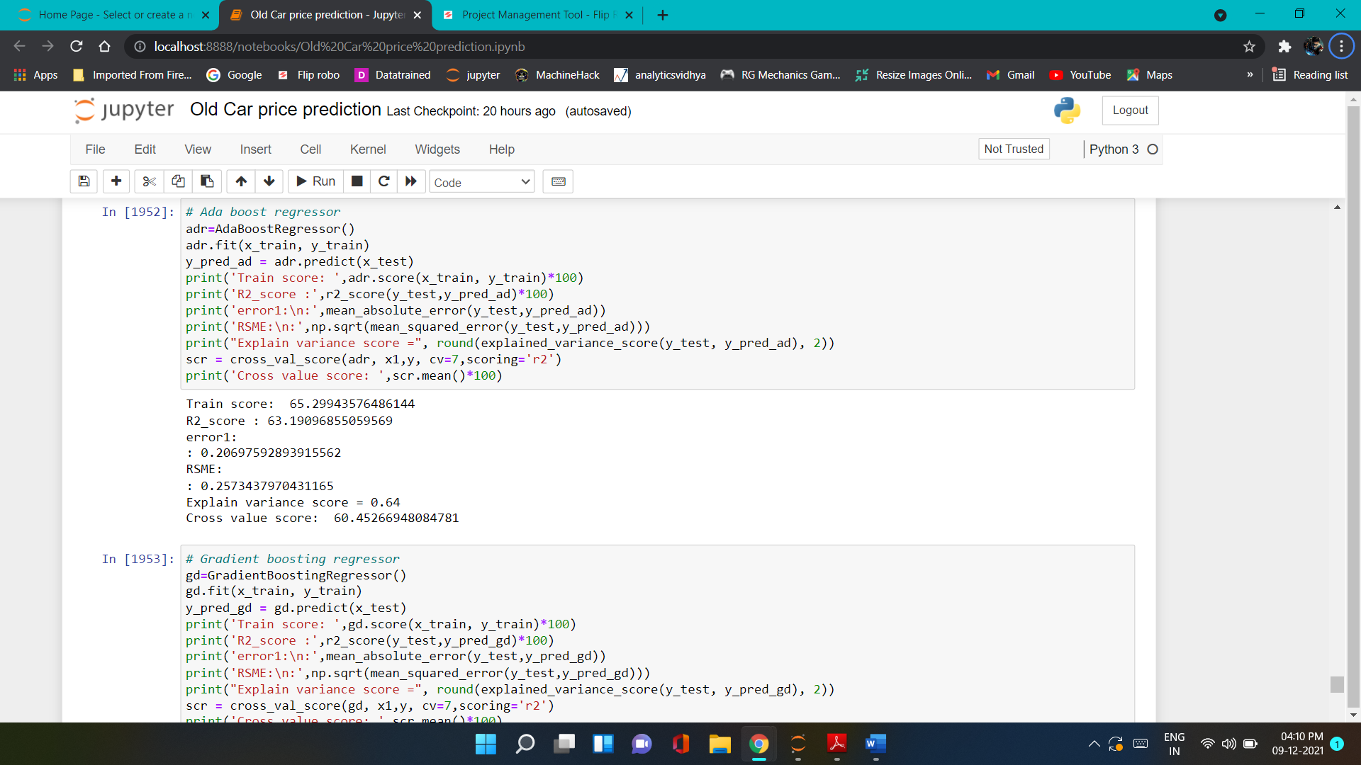
Run and evaluate select models
8).XGBoost Regressor
9).Ada Boost Regressor

Slide 25
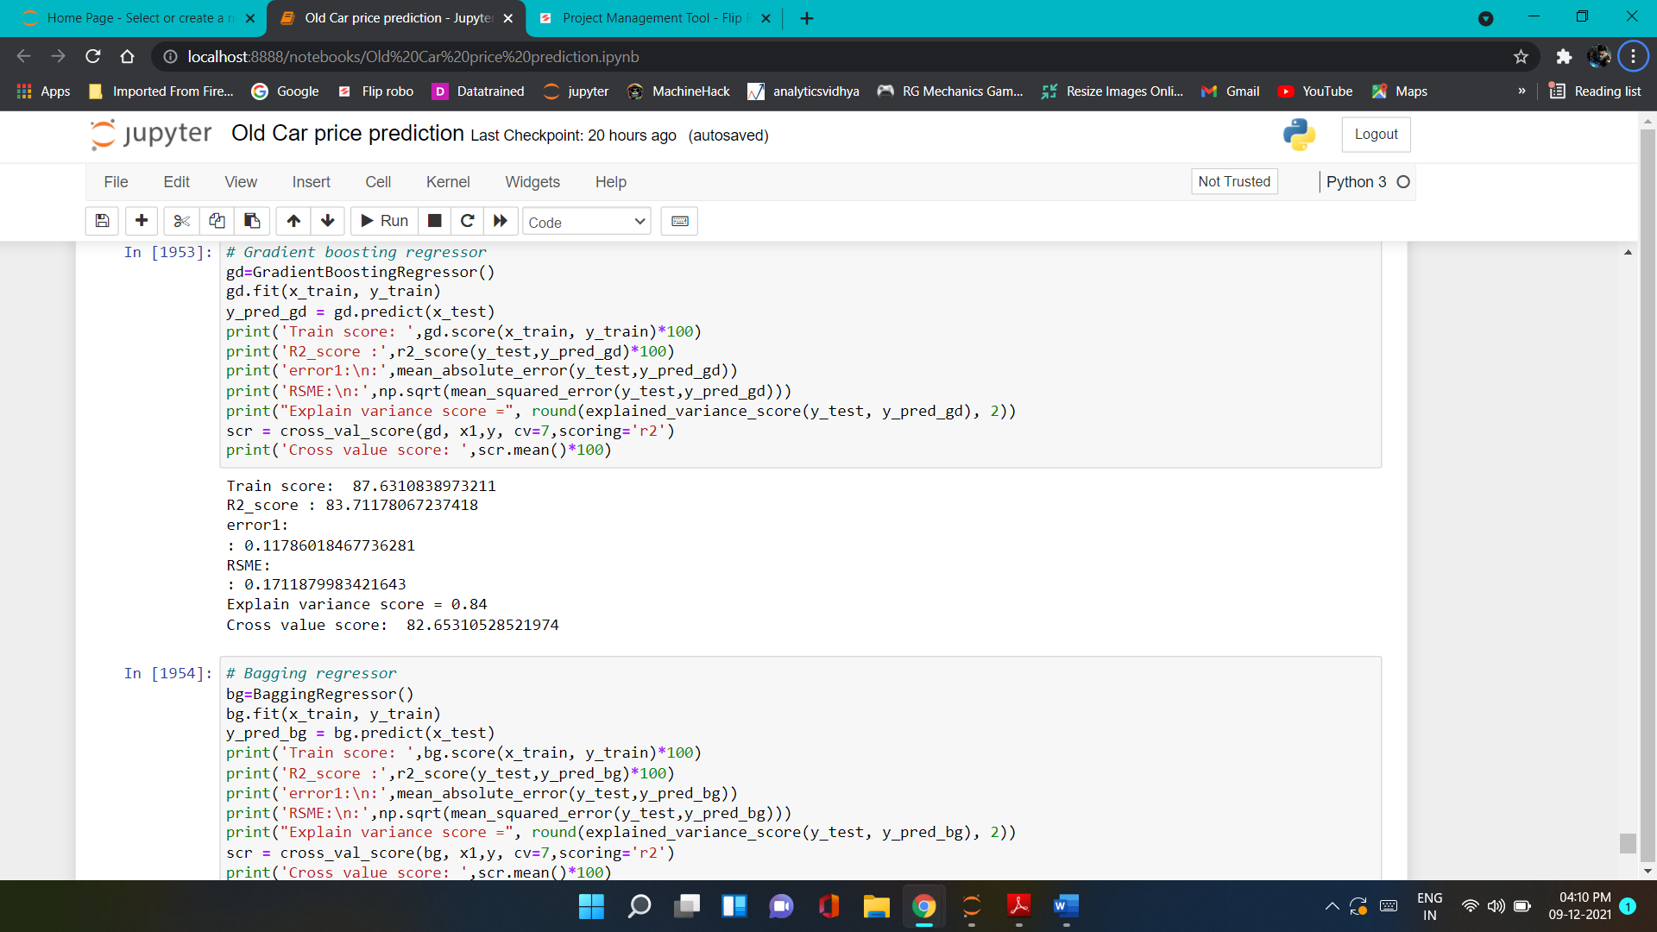
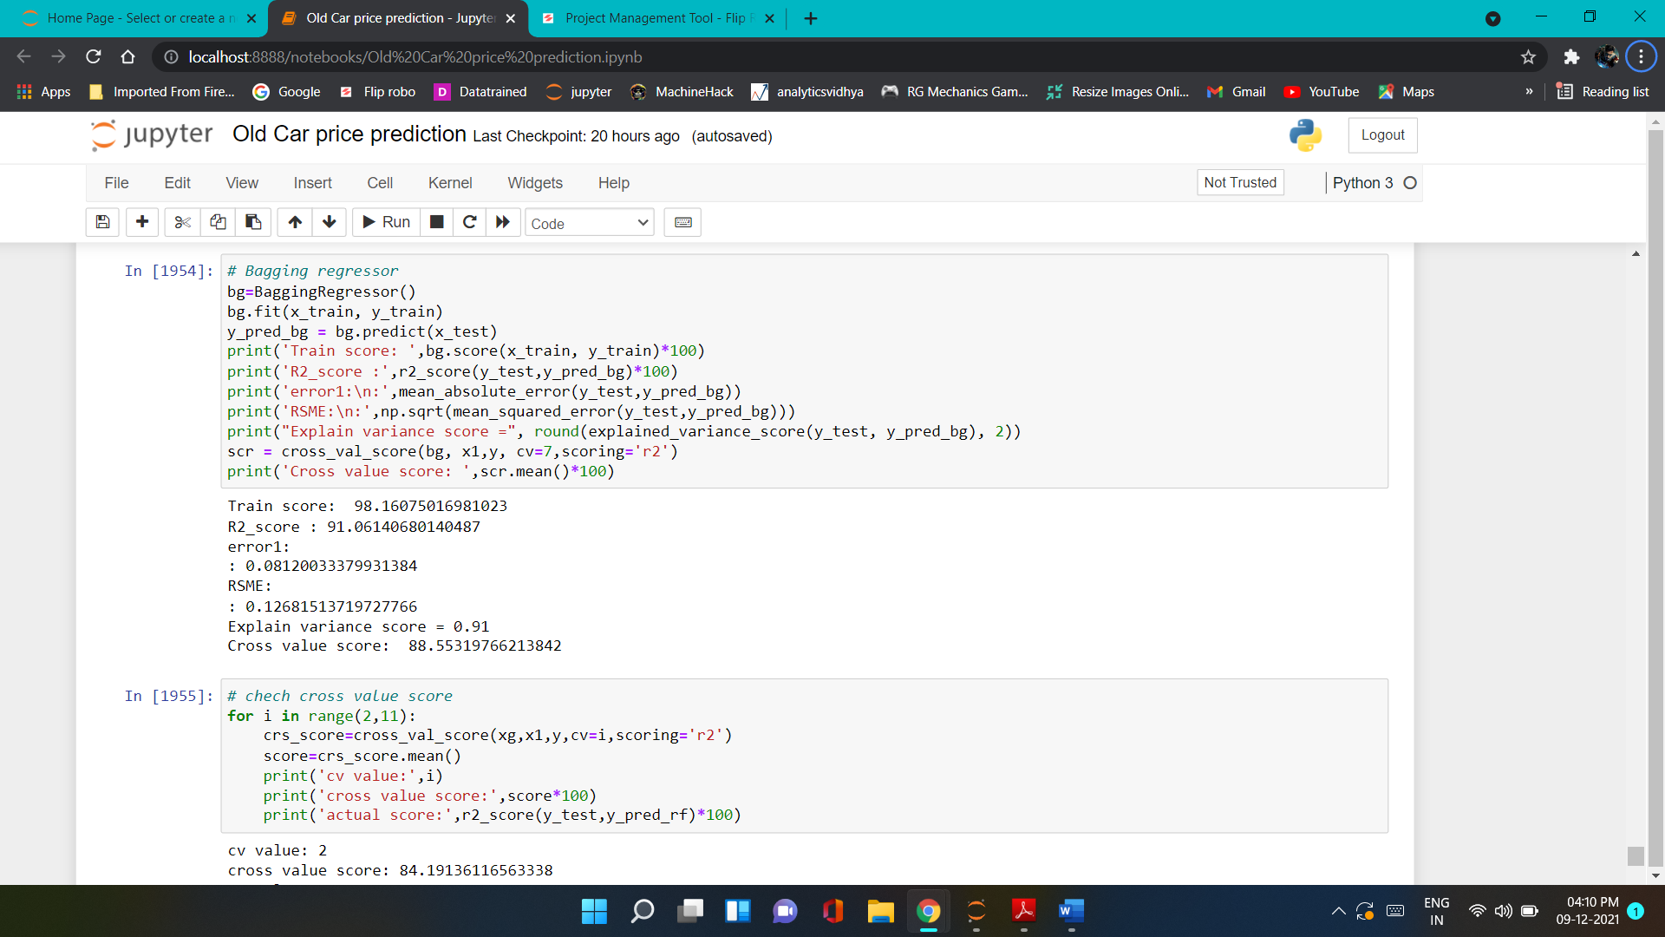
Run and evaluate select models
10).Gradient Boosting Regressor
11).Bagging Regressor

Slide 26
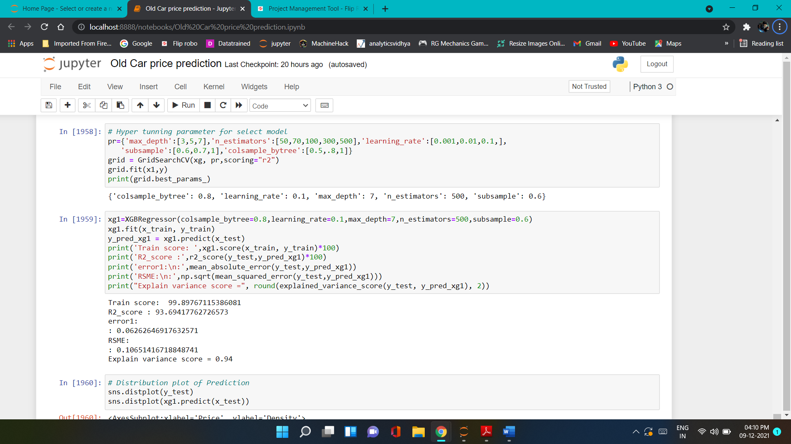
Hyper parameter tuning result

Slide 27
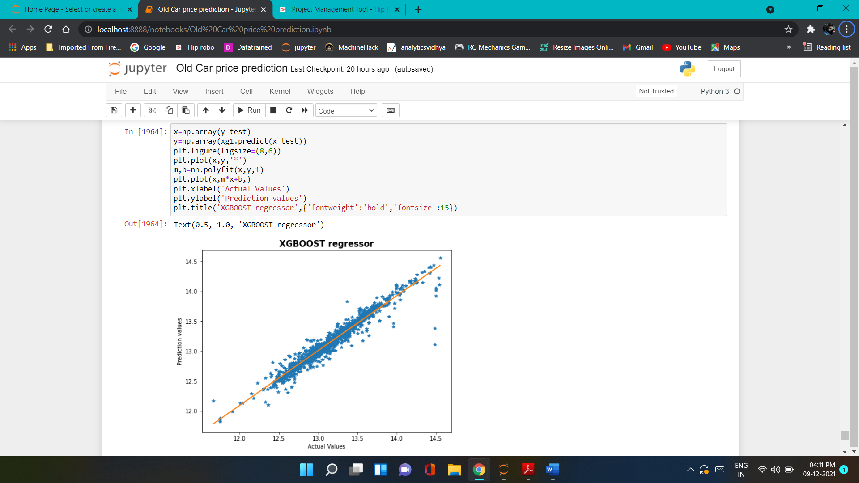
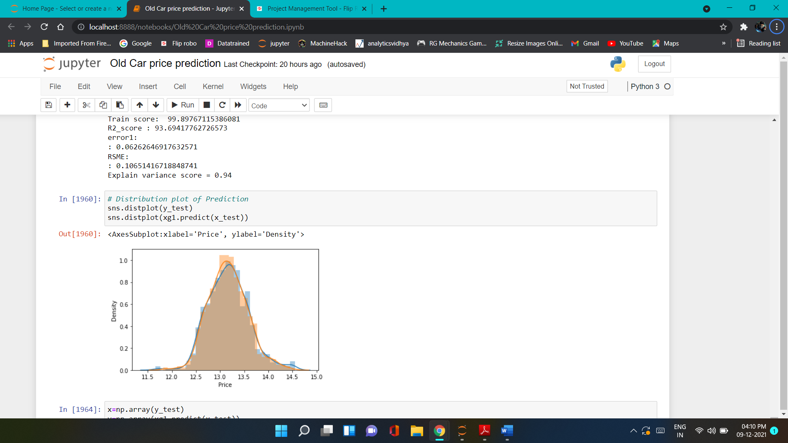
Regression and distribution plot of prediction

Slide 28
Conclusion
Key Findings and Conclusions of the Study
In this project report, we have used machine learning algorithms to predict the used car price. We have mentioned the step-by-step procedure to analyse the dataset and finding the correlation between the features. Thus we can select the features which are correlated to each other and are independent in nature. These feature set were then given as an input to four algorithms and a hyper parameter tunning was done to the best model and the accuracy has been improved. Hence we calculated the performance of each model using different performance metrics and compared them based on these metrics. Then we have also saved the best model and predicted the label. It was good the predicted and actual values were almost same.

Slide 29
Limitations of this work and Scope for Future Work
First draw back is the length of the dataset it is small because of scraping data.
Followed by a greater number of skewness these two will reduce our model accuracy.
Data scrap from the different websites so it can be change at any time so also we have update model with new data at time.
Also, we have tried best to deal with skewness and feature insight. So it looks quite good that we have achieved a accuracy of 93.69% even after dealing all these drawbacks.
Also, this study will not cover all Regression algorithms instead, it is focused on the chosen algorithm, starting from the basic ensemble techniques to the advanced ones.

Slide 30


